Slide 1
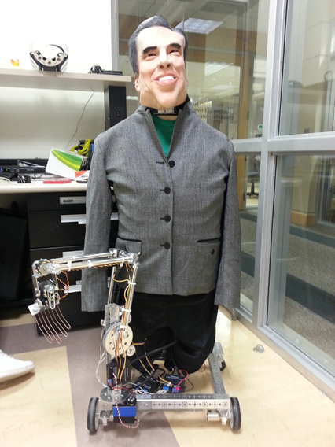
Nixon Bohr
Created by: Jordan fluth and Vernon jones

Slide 2
Inspiration
The idea for this project came after seeing a youtube video of a masters thesis project.
http://www.youtube.com/watch?v=FTBBlt9uk1A

Slide 3
hardware required
A laptop with Bluetooth connection
A Microsoft Xbox Kinect
LEGO NXT Brick
Two TETRIX motor controllers
A TETRIX servo controller
12V battery

Slide 4
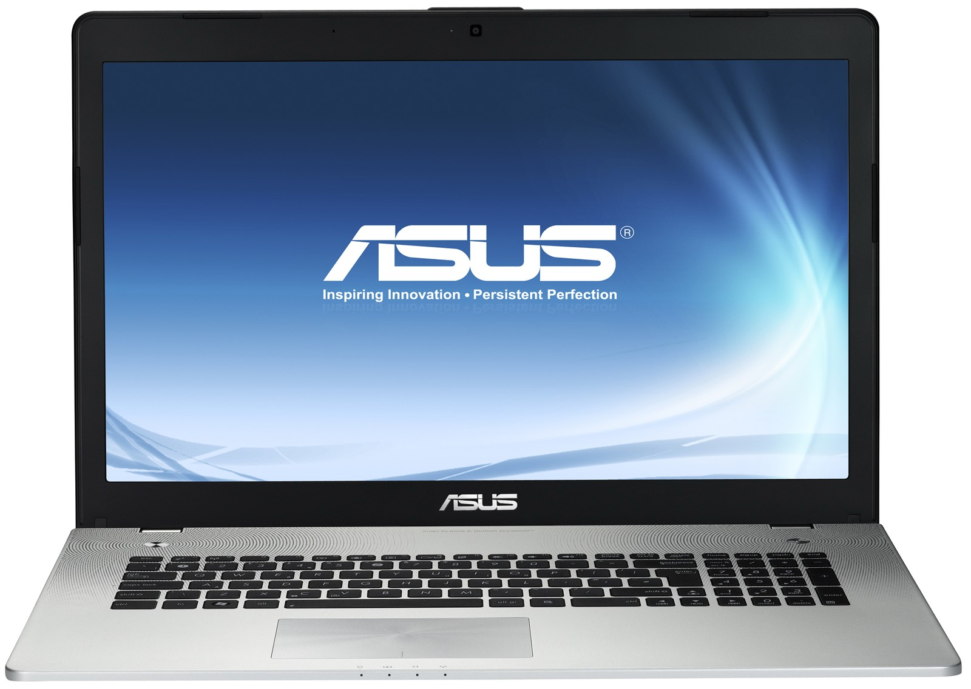
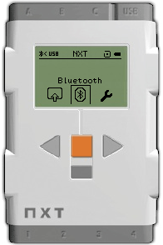
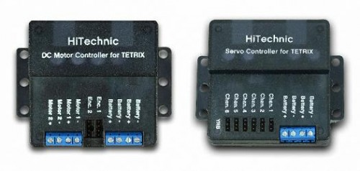

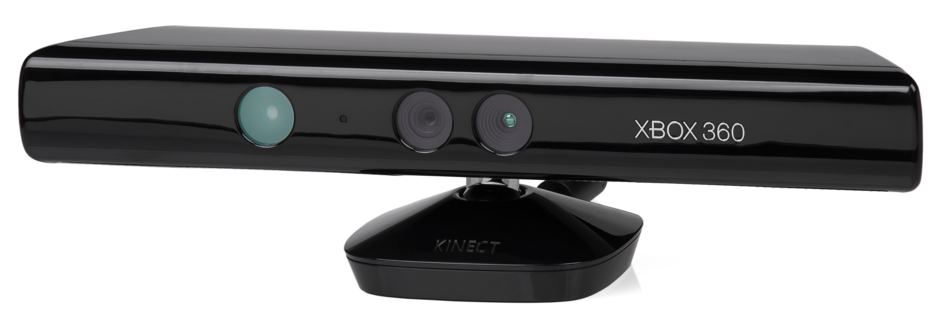
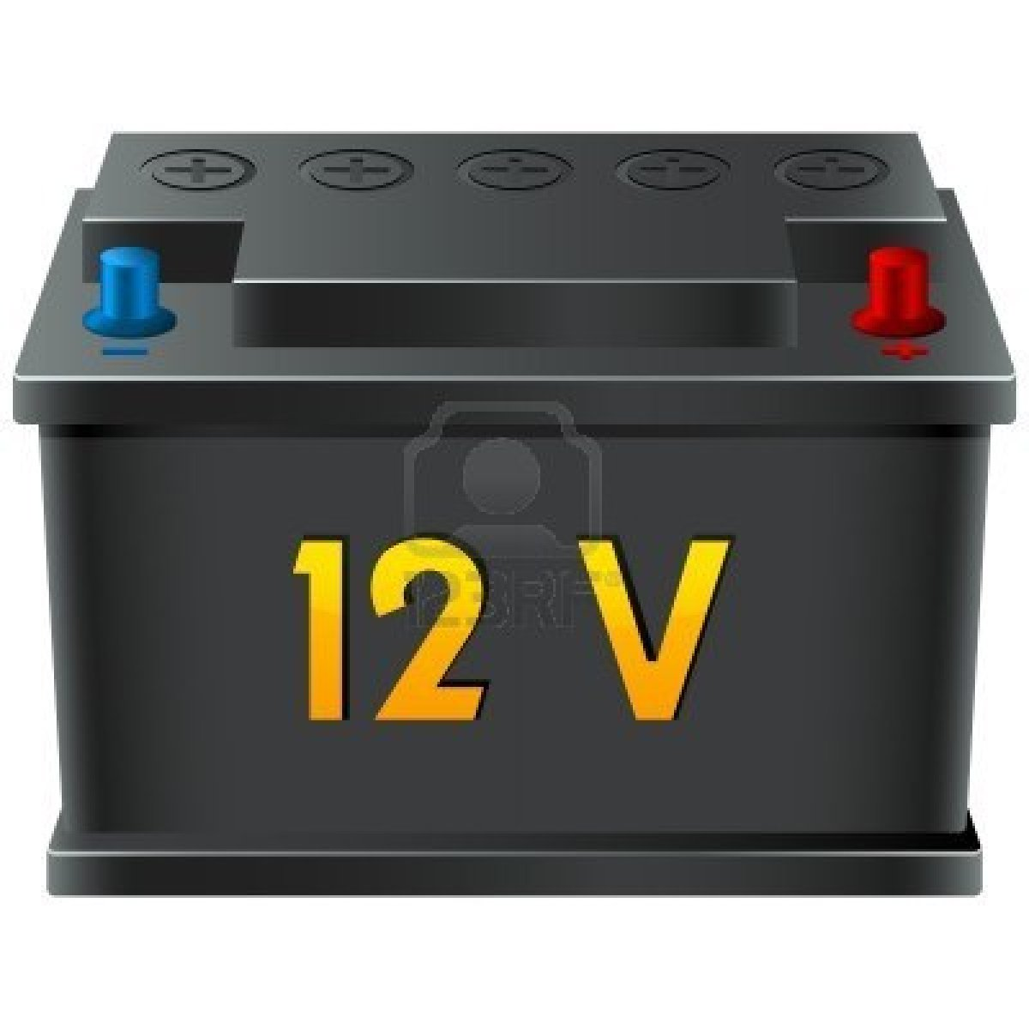
Hardware Setup

Slide 5
Software required
ROBOTC IDE
FAAST
Kinect development software

Slide 6
Initial condition of robot

Slide 7
Objective
Create serial communication between the laptop and the LEGO NXT brick over Bluetooth
Program gestures to be recognized by the Kinect and translated into physical movements on the robot for driving operations
Program gestures to be recognized by the Kinect and translated into physical movements on the robot for controlling the arm
Refine motion controls such that we drive over to an object, pick it up and place it in a desired location

Slide 8
results

Slide 9
Technical problems

Slide 10
Future plans

Slide 11
The end

